Slide 1
Object Oriented Design & Programming
Unit-6 Inheritance OODP

Slide 2
🞄 Reusability: is one of the important feature of OOP. It is always nice if we could reuse something that already exist rather than trying to create the same all over again.
Reusability
🞄 It would not only save time and money but also reduce
frustration and increase reliability.
🞄 For instance, the reuse of a class that has already been tested, debugged and used many times can save us the effort of developing and testing the same again.

Slide 3
reusability through inheritance.
🞄 Fortunately, C++ strongly supports the concept of
🞄 The mechanism of deriving a new class from an old one is
called inheritance (or derivation).
Inheritance
🞄 The old class is referred to as the base class and the new
one is called the derived class or subclass.
🞄 The derived class inherits some or all of the traits from the
base class.
🞄 A class can also inherit properties from more than one class
or from more than one level.

Slide 4
2. Multiple Inheritance
1. Single Inheritance
Types of Inheritance
Hierarchical Inheritance
Multilevel Inheritance
Hybrid Inheritance

Slide 5
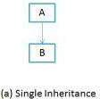
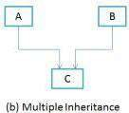
inheritance.
a) A derived class with only one base class, is called single
b) A derived class with several base class, is called Multiple inheritance. It means that a class can also inherit properties from more than one classes.
Types of Inheritance

Slide 6
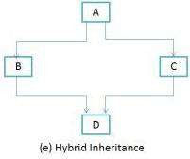
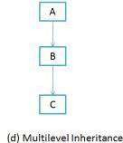
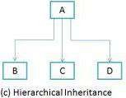
c) Properties of one class may be inherited by more than one classes. This process is known as hierarchical inheritance.
The mechanism of deriving a class from another “derived
class” is known as multilevel inheritance.
There could be a situation where we need to apply two or more types of inheritance. That is called hybrid inheritance.
Types of Inheritance

Slide 7

🞄 A derived class can be defined by specifying its relationship with the base class in addition to its own details. The general form of defining a derived class is:
Defining Derived Classes
🞄 The visibility-mode is optional and, if present, may be either private or protected or public. It is private by default.
🞄 Colon indicates that derived class is derived from the base class.
🞄 Visibility mode specifies that how the features of base class is
derived.

Slide 8
class ABC: private XYZ
{
members of ABC
};
class ABC: public XYZ
{
members of ABC
};
class ABC: protected XYZ
{
members of ABC
};
// Private Derivation
// Public derivation
// Protected Derivation
Defining Derived Classes
🞄 Visibility mode specifies whether the features of the base class are
privately derived or protectedly derived or publicly derived.
🞄 In this example: XYZ is the base class and ABC is the derived class.

Slide 9
🞄 When deriving a class from a base class, the base class may be inherited through public, protected or private inheritance. The type of inheritance is specified by the access specifier.
Access Control and Inheritance
🞄 We hardly use protected or private inheritance, but public
inheritance is commonly used.
🞄 The keywords private, protected, and public may appear in any order and any number of times in the declaration of a class.

Slide 10
inherited) :
🞄 Public Inheritance (when the base class is publicly
Access Control and Inheritance
🞄 Public members of the base class become public members of the derived class and therefore they are accessible to the objects of derived class.
🞄 Protected members of the base class become protected
members of the derived class.
🞄 A base class's private members are never accessible directly
from a derived class.

Slide 11
Access Control and Inheritance
🞄 Protected Inheritance (When deriving from a protected base class):
🞄 public and protected members of the base class become
protected members of the derived class.
🞄 A base class's private members are never accessible directly from a derived class.

Slide 12
🞄 Private Inheritance (When deriving from a private base class) :
🞄 public and protected members of the base class become
private members of the derived class.
🞄 Therefore the public members of the base class can only be accessed by the member functions of the derived class. They are inaccessible to the objects of the derived class.
🞄 Remember, a public member of a class can be accessed by
its own objects using the dot operator.
🞄 The result is that no member of the base class is accessible to the objects of the derived class.
Access Control and Inheritance

Slide 13
Example
class A { public: int x; protected: int y; private: int z; }; class B : public A { // x is public // y is protected // z is not accessible }; | class C : protected A { // x is protected // y is protected // z is not accessible }; ----------------------------------------- class D : private A { // x is private // y is private // z is not accessible };

Slide 14
🞄 A derived class inherits all base class methods with the
following exceptions:
Access Control and Inheritance
Constructors, destructors and copy constructors of the
base class.
Overloaded operators of the base class.
The friend functions of the base class.

Slide 15
🞄 In inheritance, some of the base class data elements and member functions are 'inherited’ into the derived class. We can add our own data and member functions and thus extend the functionality of the base class.
Inheritance
🞄 Inheritance, when used to modify and extend the capabilities of the existing classes, becomes a very powerful tool for incremental program development.

Slide 16
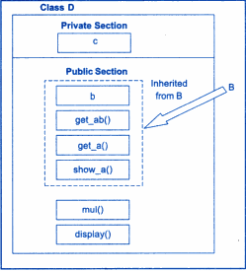
class B
{
int a;
public:
int b;
void get_ab(); int get_a(); void show_a();
};
class D : public B
{
int c;
public:
void mul(); void display();
};
Single Inheritance by public

Slide 17
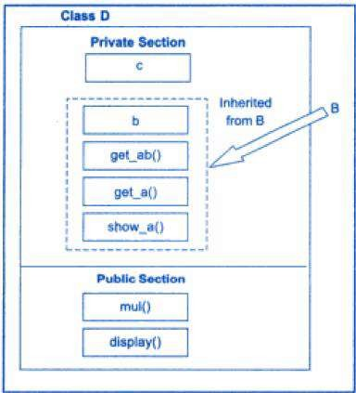
class B
{
int a;
public:
int b;
void get_ab(); int get_a(); void show_a();
};
class D : private B
{
int c;
public:
void mul(); void display();
};
Single Inheritance by private

Slide 18
Single Inheritance Example
class B { int a; public: int b; void get_ab(); int get_a(); void show_a(); }; class D : public B { int c; public: void mul(); void display(); }; void B::get_ab() { a=5; b=10; } int B::get_a() { return a; } | void B::show_a() { cout<<"a="<<a<<endl; } void D::mul() { c=b*get_a(); //b*a; } void D::display() { cout<<"a="<<get_a()<<endl; cout<<"b="<<b<<endl; cout<<"c="<<c<<endl; } int main() { D d; d.get_ab(); d.mul(); d.display(); d.b=20; d.mul(); d.display(); }

Slide 19
🞄 Private data members are not inheritable so to make private variables accessible in the derived class, we have to modify its visibility level and make it protected instead of private.
Making Private Member Inheritable
🞄 A member declared protected is accessible by the member functions within its class and any class immediately derived from it.
🞄 It cannot be accessed by the functions outside these two
classes.

Slide 20
class alpha
{
private: // optional
…………. // visible to member functions within its class
protected:
………… // visible to member functions
………… // of its own and derived class
public:
………… // visible to all functions
………… // in the program
};
Visibility of Members

Slide 21
protected members of a class:-
🞄 Various functions that can have access to the private and
A function that is a friend of the class
A member function of a class that is a friend of the class
A member function of a derived class
Visibility of private and protected Members
🞄 While the friend functions and the member functions of a friend class can have direct access to both the private and protected data, the member functions of a derived class can directly access only the protected data.

Slide 22
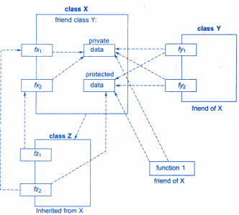
Visibility of private and protected Members

Slide 23
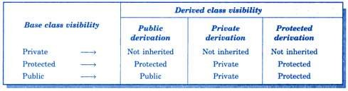
Visibility of Inherited Members

Slide 24
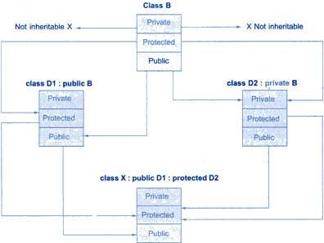
Visibility of Inherited Members

Slide 25
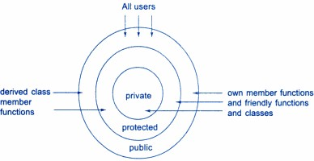
Access Mechanism in Classes

Slide 26
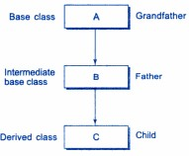
🞄 The class A serves as a base class for the derived class B, which in turn serves as a base class for the derived C.
Multilevel Inheritance
🞄 The class B is known as intermediate base class since it provides a link for inheritance between A and C.
🞄 The chain ABC is known as
inheritance path.

Slide 27
🞄 A derived class with multilevel inheritance is declared as
follows:
Multilevel Inheritance
🞄 class A{.…….} ;
🞄 class B: public A { ..........};
🞄 class C: public B { ..........};
// Base class
// B derived from A
// C derived from B
🞄 This process can be extended to any number of levels.

Slide 28
class student { protected: int r_no; public: void get_no(int); void put_no(); }; void student:: get_no(int a) { r_no=a; } void student::put_no() { cout<<"Roll No:"<<r_no<<endl; } | class test : public student { protected: float sub1, sub2; public: void get_marks(float,float); void put_marks(); }; void test:: get_marks(float x,float y) { sub1=x; sub2=y; } void test:: put_marks() { cout<<"Marks in sub1="<<sub1<<endl; cout<<"Marks in sub2="<<sub2<<endl; } | class result : public test { float total; public: void display(); }; void result:: display() { total=sub1+sub2; put_no(); put_marks(); cout<<"Total="<<total<<endl; } int main() { result student1; student1.get_no(001); student1.get_marks(75, 59.5); student1.display(); }

Slide 29
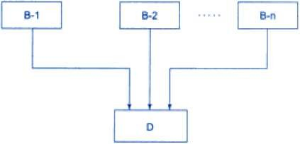
is known as multiple inheritance.
🞄 A class can inherit the attributes of two or more classes. This
🞄 Multiple inheritance allows us to combine the features of several existing classes as a starting point for defining new classes.
🞄 It is like a child inheriting the physical features of one parent
and the intelligence of another.
Multiple Inheritance

Slide 30

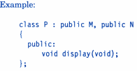
🞄 The syntax of a derived class with multiple base classes is as
follows :
Multiple Inheritance
🞄 The base classes are separated by commas.

Slide 31
class M
{
protected:
int m;
public:
void get_m(int);
};
class N
{
protected:
int n;
public:
void get_n(int);
};
class P : public M, public N
{
public:
void display();
};
void M:: get_m(int x)
{
m=x;
}
void N:: get_n(int y)
{
n=y;
}
void P:: display()
{
cout<<"m="<<m<<endl; cout<<"n="<<n<<endl; cout<<"m*n="<<m*n<<endl;
}
int main()
{
P obj; obj.get_m(10); obj.get_n(20); obj.display();
}
Example

Slide 32
🞄 Occasionally, we may face a problem in using the multiple inheritance, when a function with the same name appears in more than one base class. Consider the following two classes.
class M { public: void display(void) { cout<< “Class M \n”; } }; | class N { public: void display(void) { cout<< “Class N \n”; } };
Ambiguity Resolution in Inheritance
class P : public M, public N
{
…….
};
Which display() function is used by the derived class?

Slide 33
Ambiguity Resolution in Inheritance
int main( )
{
P obj;
obj. display( );
// Ambiguity display() of M or N ?
obj. M :: display( ); // invokes the display of M
obj. N :: display( ); // invokes the display of N return 0;
}

Slide 34
instance, consider the following situation:
🞄 Ambiguity may also arise in single inheritance applications. For
class A { public: void display() { cout<< “A \n”; } }; class B : public A { public: void display() { cout<< “B\n”; } }; | int main() { B ob; // derived class object ob.display(); //invokes display() in B ob.A::display(); //invokes display() in A ob.B::display(); //invokes display() in B return 0; }
Ambiguity Resolution in Inheritance

Slide 35
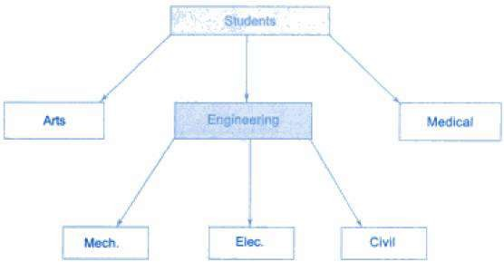
🞄 Many programming problems can be cast into a hierarchy where certain features of one level are shared by many others below that level.
Hierarchical Inheritance

Slide 36
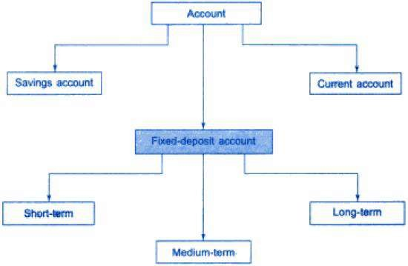
Hierarchical Inheritance

Slide 37
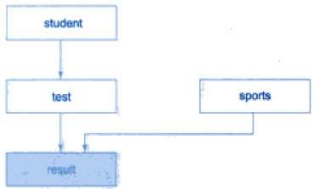
types of inheritance to design a program.
🞄 There could be situations where we need to apply two or more
🞄 Example:
🞄 Processing the student’s result. Assume that we have to give weightage for sports before finalizing the results. The weightage for sports is stored in a separate class called sports.
Hybrid Inheritance

Slide 38
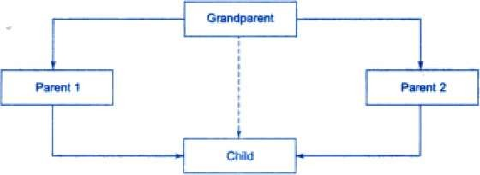
🞄 The 'grandparent’ is sometimes referred to as indirect base class.
🞄 ‘Child’ would have duplicate sets of the members inherited from
'grandparent'. This introduces ambiguity and should be avoided.
Virtual Base Class

Slide 39
🞄 The duplication of inherited members due to these multiple paths can be avoided by making the common base class (ancestor class) as virtual base class.
Virtual Base Class
🞄 When a class is made as virtual base class, C++ takes necessary care to see that only one copy of that class is inherited, regardless of how many inheritance paths exist between the virtual base class and a derived class.
🞄 The keywords virtual and public may be used in either order.

Slide 40
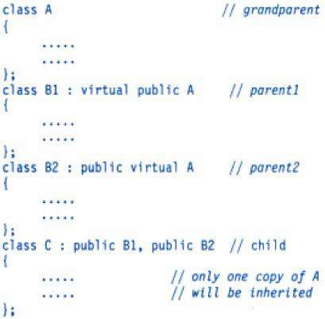
Virtual Base Class

Slide 41
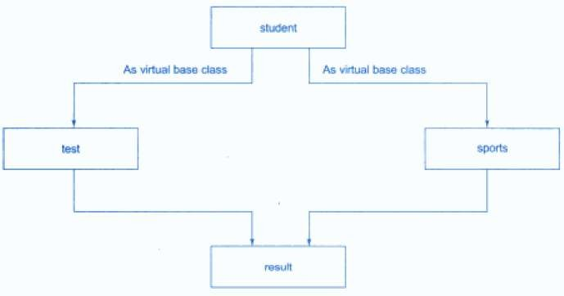
Virtual Base Class

Slide 42
🞄 Abstract class is the one which is not used to create objects.
An abstract class is designed only to act as a base class (to
be inherited by other classes).
Abstract Class
🞄 It is a design concept in program development and provides
a base upon which other classes may be built.
🞄 In the previous example, the student class was an abstract
class since it was not used to create any objects.

Slide 43
🞄 As long as no base class constructor takes any arguments,
the derived class need not have a constructor function.
🞄 However, if any base class contains a constructor with one or more arguments, then it is mandatory for the derived class to have a constructor and pass the arguments to the base class constructors.
🞄 Remember, while applying inheritance we usually create objects using the derived class. Thus, it makes sense for the derived class to pass arguments to the base class constructor.
🞄 When both the derived and base classes contain constructors, the base constructor is executed first and then the constructor in the derived class is executed.
Constructors in Derived Classes

Slide 44
🞄 In case of multiple inheritance, the base classes are constructed in the order in which, they appear in the declaration of derived class.
Constructors in Derived Classes
🞄 In multilevel inheritance, the constructor will be executed in the
order of Inheritance.
🞄 Here, the derived class is taking responsibility of supplying initial
values to its base class.
🞄 How derived class do that job?
🞄 The constructor of the derived class receives the entire list of values as its arguments and pass them on the base constructor in the order in which they are declared in the derived class.

Slide 45
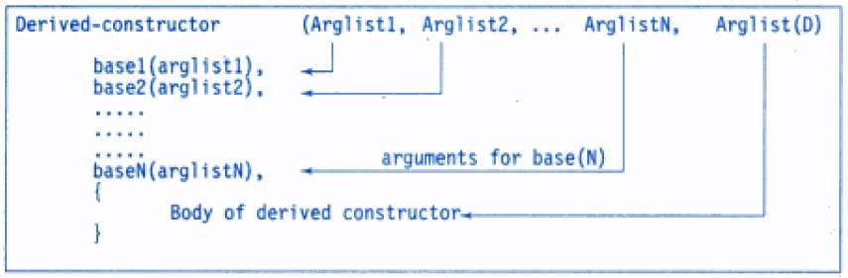
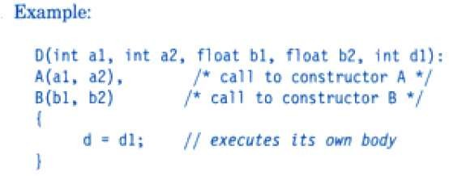
🞄 General form of defining a derived class constructor:
Constructors in Derived Classes

Slide 46

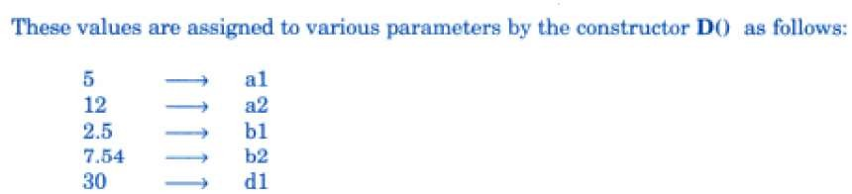
invokes another base constructor B().
🞄 Here, A(a1, a2) invokes the base constructor A() and B(b1, b2)
🞄 The constructor D() supplies values for these four arguments. In
addition it has one argument of its own.
🞄 So, the constructor D() has a total of 5 arguments.
🞄 D() may be invoked as:
Constructors in Derived Classes

Slide 47
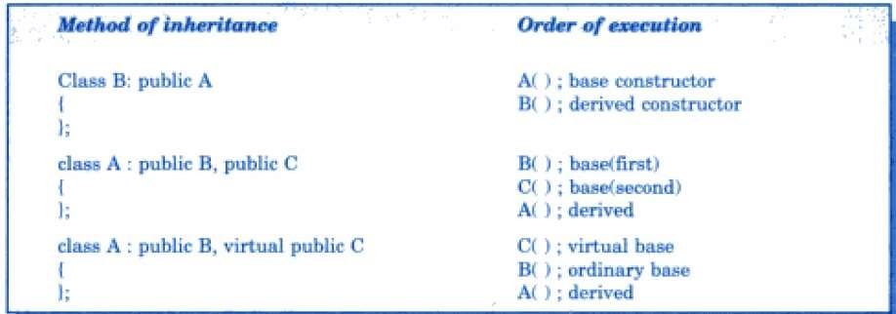
Execution of base class constructors

Slide 48
class alpha { int x; public: alpha(int i) { x=i; cout<<"Aplha Initialized \n"; } void show_x() { cout<<"X= "<<x<<endl; } }; class beta { float y; public: beta(int j) { y=j; cout<<"Beta Initialized \n"; } | void show_y() { cout<<"Y= "<<y<<endl; } }; class gamma : public beta, public alpha { int m, n; public: gamma(int a, float b, int c, int d) : alpha(a), beta(b) { m=c; n=d; cout<<"Gamma Initialized \n"; } void show_mn() { cout<<"m= "<<m<<endl; cout<<"n= "<<n<<endl; } }; | int main() { gamma g(5, 10.75, 20, 30); cout<<"\n"; g.show_x(); g.show_y(); g.show_mn(); } Beta is initialized first, although it appears second in derived constructor. This is because it has been declared first in the derived class header line. Here, alpha(a) and beta(b) are constructor call from gamma class.

Slide 49
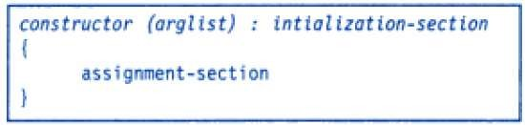
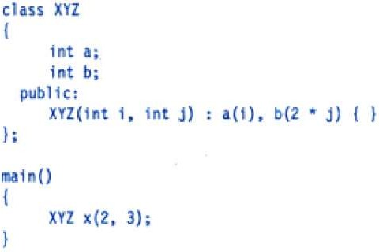
🞄 Assignment section is body part of constructor function.
🞄 The part immediately after colon is known as the initialization
section.
🞄 We can use this section to provide initial values to the base
constructors and also to initialize its own class members.
Another way to initialize values in Constructors
This will initialize a to 2 and b to 6.

Slide 50
Thank you

